Slide 1
Beginning Software Craftsmanship
Brendan Enrick
Brendan.Enrick.com
@brendoneus
Steve Smith
Ardalis.com
@ardalis
Notes:
Welcome everyone and good morning. Glad everyone fought through the hangovers to make it here bright and early in the morning. My name is Brendan Enrick and this is Steve Smith, and today we’re going to be talking about software craftsmanship.
I’d like to start out by finding out who here has at least heard about software craftsmanship before? OK awesome. Anyone here read the software craftsmanship manifesto?
OK. Well this is a beginners course designed to introduce what softare craftsmanship is, why it’s important, and is heavily focused on the individual’s interest in software craftsmanship and less on the community. If you’d like to talk about that afterwards, I think either of us would be glad to discuss it with you after the session.

Slide 2
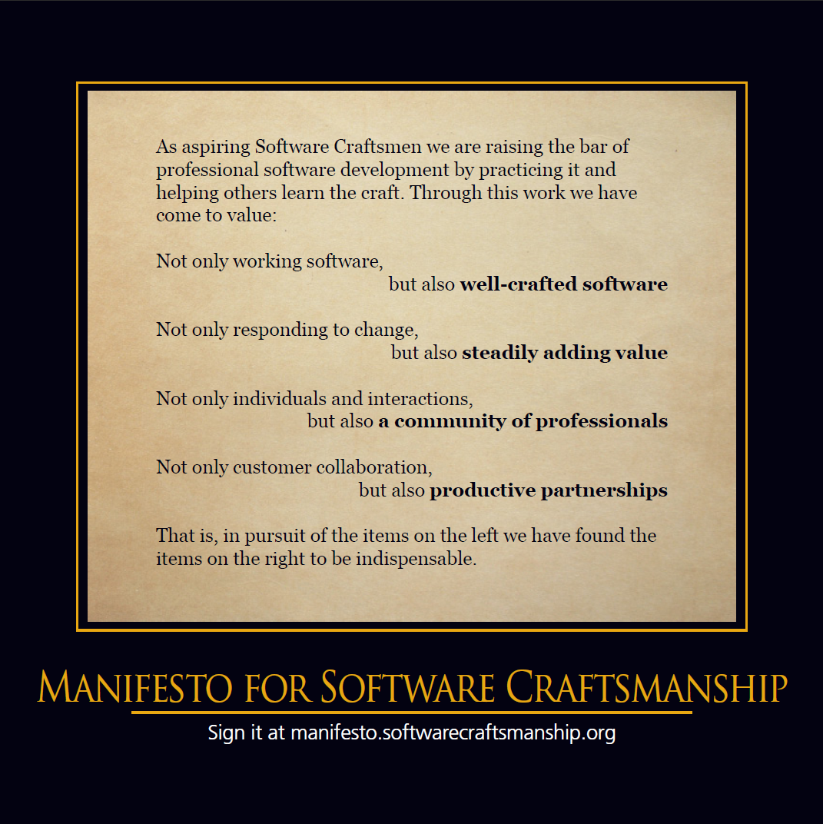

Slide 3
Software Craftsmanship TL;DR
Agile++

Slide 4
Software Craftsmanship TL;DR
Agile++
Practice, teach, and learn so that we can steadily add value to well-crafted software, promote a strong community of professionals, and partner closely with others.

Slide 5

Why Practice?
Notes:
<div xmlns:cc="http://creativecommons.org/ns#" about="http://www.flickr.com/photos/usonian/130586983/"><a rel="cc:attributionURL" href="http://www.flickr.com/photos/usonian/">http://www.flickr.com/photos/usonian/</a> / <a rel="license" href="http://creativecommons.org/licenses/by-nc-sa/2.0/">CC BY-NC-SA 2.0</a></div>

Slide 6
Hey! I know how to code. I don’t need to practice.

Slide 7
Hey! I already practice. I write code daily.

Slide 8
Practice (learning method)
Practice is the act of rehearsing a behavior over and over, or engaging in an activity again and again, for the purpose of improving or mastering it, as in the phrase "practice makes perfect".
http://en.wikipedia.org/wiki/Practice_(learning_method) 17 October 2012

Slide 9
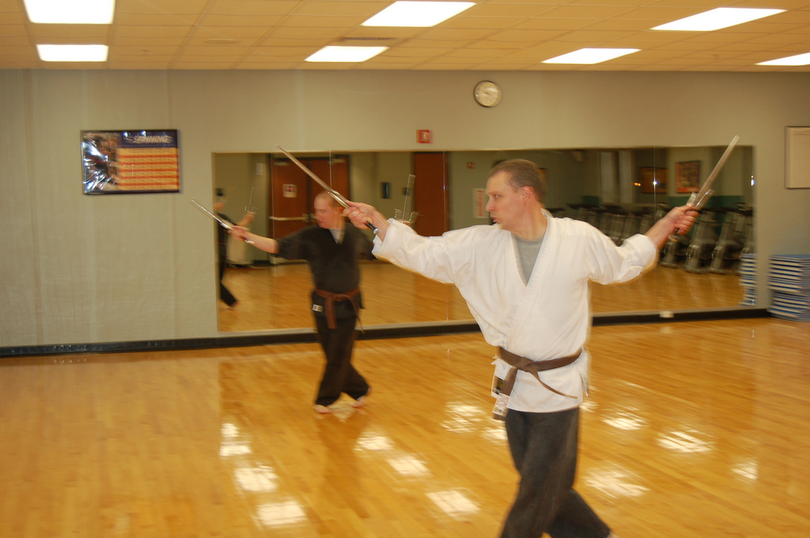
Katas

Slide 10
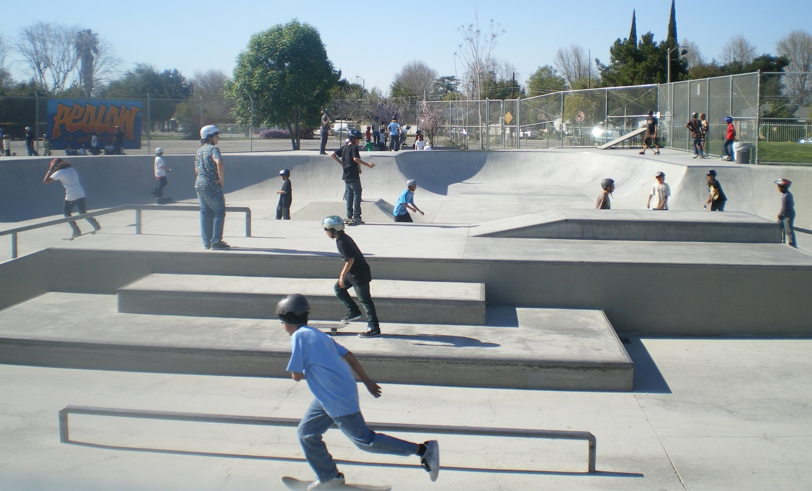
Exercises

Slide 11

Stretch

Slide 12

Grow

Slide 13
How to Practice
Pair Programming
Trying new things
Get out of your comfort zone
Repetition, repetition, and repetition.

Slide 14
Where do I learn more?
http://HudsonSC.com
http://softwarecraftsmanship.org
http://groups.softwarecraftsmanship.org
http://ProjectEuler.net
http://CodingDojo.org
http://codekata.pragprog.com

